Slide 1
DEPARTMENT OF ELECTRONICS AND COMMUNICATION ENGINEERING Academic Year 2024-2025 (EVEN SEM)
ECB1223 – MICROCONTROLLERS AND INTERFACING

Slide 2
TEMPERATURE TUNED FANS
Team members Guide Name
AKSHAYA N S (927623BEC006) Dr.K.Karthikeyan
CHANDIKA K (927623BEC020)
DEEPIKA S (927623BEC023)
DHARANI S (927623BEC029)

Slide 3
Objective
The objective of this project is to design a temperature-tuned fan using a microcontroller for automatic speed control. The system will read real-time temperature data using a sensor and adjust the fan speed accordingly. This will improve user comfort by maintaining an optimal room temperature without manual adjustments. It will also help reduce energy consumption by running the fan only as needed. The goal is to create an efficient, cost-effective, and user-friendly fan control system.

Slide 4
LITERATURE SURVEY
Numerous studies and projects have explored temperature-based fan control systems to enhance energy efficiency and automation. Traditional systems use thermistors or analog sensors to regulate fan speed, but they lack remote monitoring and adaptability.
Recent advancements in IoT have introduced modules like ESP8266 and ESP32, enabling real-time data collection and control over Wi-Fi. Research shows that integrating temperature sensors such as DHT11 or LM35 with IoT platforms allows for precise environmental monitoring and dynamic fan control.
Projects using platforms like Blynk, ThingSpeak, and Firebase have demonstrated the effectiveness of cloud-based interfaces for remote access. Studies also highlight the potential of threshold-based automation, reducing energy consumption and improving user convenience.

Slide 5
Problem Analysis
Conventional fan systems lack automation, real-time monitoring, leading to inefficient energy use and inconsistent cooling. Manual control is impractical in fluctuating environments, especially in large areas. This results in higher electricity costs, reduced device lifespan, and poor thermal comfort. A temperature-based, IoT-enabled system can address these issues by offering smart, responsive control, improving energy efficiency and convenience.

Slide 6
Solution
The proposed method uses an Arduino-based automatic fan control system that adjusts speed based on real-time temperature readings from a sensor (DHT11). The Arduino processes the data and generates a PWM signal to control the fan speed via a motor driver (MOSFET). The fan runs at different speeds based on temperature thresholds, ensuring energy efficiency and automatic cooling. An LCD display shows temperature and fan status, and IoT integration (optional) allows remote monitoring. This system is cost-effective, scalable, and suitable for smart home automation.

Slide 7
Technology Adopted
Microcontroller (ESP32 / Arduino):Core controller used for processing sensor data and controlling fan speed.
Temperature Sensor (DHT11 / LM35):Measures ambient temperature and sends data to the microcontroller.
PWM (Pulse Width Modulation):Technique used to control fan speed based on temperature readings.

Slide 8
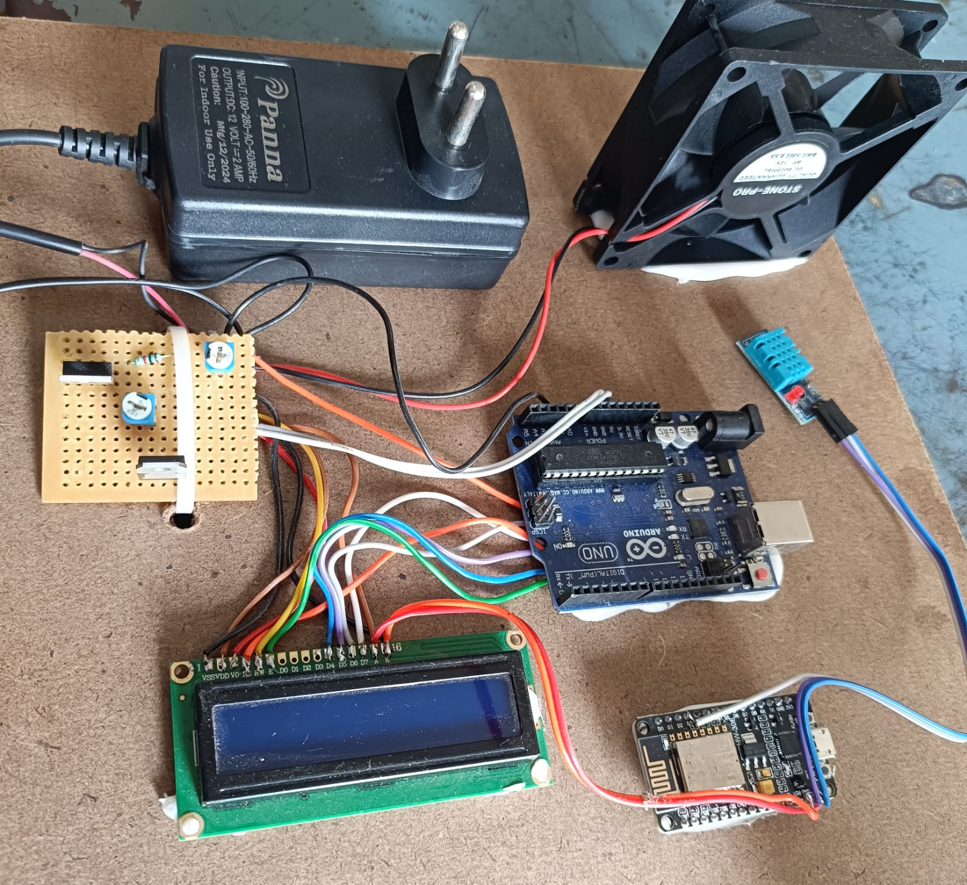
Connection Diagram

Slide 9
Conclusion
The project successfully demonstrates an automatic fan control system using a microcontroller and IoT. It adjusts fan speed based on temperature and allows monitoring, making it energy-efficient and user-friendly for smart home applications.

Slide 10
References
K Sai Kumar, Sirolla Rajasekhar, Shaik Haseeb Tanveer, S Venkata Prasad, Reddy, Valthati Allababu, K A Rahman. AUTOMATIC TEMPERATURE BASED FAN CONTROLLER. Journal of Engineering Sciences. Vol 14 Issue 05,2023
M. A. A. Mashud, Dilruba Yasmin, M. A. Razzaque and M. H. Uddin. AUTOMATIC ROOM TEMPERATURE CONTROLLED FAN SPEED CONTROLLER USING PT-100. International Journal of Scientific & Engineering Research, Volume 6, Issue 8, August-2015. ISSN 2229-5518

